Slide 1


- take 2
History
Philosophy
Technologies
Who is using it?
Notes:
What will I talk about?

Slide 2


History
Play! 1 first published in 2008
Play! 1 v1.0 released in Oct 2009
Created by Guillaume Bort (in Zenexity)
Other releases added support for:
OAuth
HTTPS
Scala
Notes:
Guillaume Bort also known for being involved in development of Groovy.
OAuth – open standard to authorisation → allows users share private resources (f.ex. photos, films, contacts) stored on one website with another website without the need to provide credentials.
HTTPS – a communication protocol for secure communication over computer network. The main motivation for HTTPS is to prevent wiretapping and man-in-the-middle attacks.

Slide 3

History
Play! 2 released in March 2012
part of stack
completely different framework
core written in Scala with Java API (not the other way around)
Ebean for persistance (not Hibernate)
Scala for templates (not Groovy)
Notes:
Typesafe – company founded by Martin Odersky (creator of Scala)
Typesafe stack →
solution stack – a set of software subsystems or components needed to create a complete platform such that no additional software is needed to support applications

Slide 4
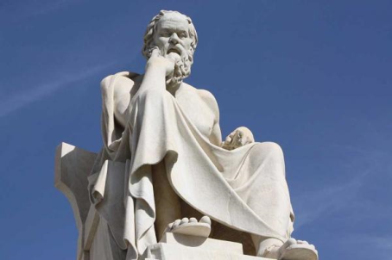
Philosophy
scaling horizontally can be cheaper and more flexible
web apps can be deployed anywhere if they are self managed and self hosted
web apps should be as stateless as possible to scale horizontally
apps need to be non-blocking to support high concurrency
Notes:
The creators of Play! Believe that…
- scaling horizontally →
self managed and self hosted → they provide their own small server that can accommodate single application
stateless →
concurrency →

Slide 5

Technologies
Play executable and Play framework
Play framework libraries:
Netty (web server)
Akka
Logback
Views
CoffeScript and LESS
WebSockets and Server-Sent Events
JDBC and JPA ORM
ORM: Ebean
H2 in-memory database
Junit and Selenium
components can be overwritten
Notes:
Play! consists of many common libraries and technologies
Play executable and Play framework
Play executable
is a command line tool (u can create, run, test apps and also package apps for deployment as standalone executable jars)
consists of a few JVM-based tools and SBT
There are a range of technologies under the hood. Play! is self-hosted; this means rather than having to deploy a web container, it will run its own dedicated HTTP server per application. It will use Netty to do so.
Netty is a non-blocking I/O (NIO) client-server framework for the development of Java network applications such as protocol servers and clients
The core of Play! code is built on top of Akka, a toolkit for creating concurrent applications on the JVM. Akka allows to create actors that send messages.
Logging in Play! is provided by Logback, a popular Java-based logging framework.
Views are Scala based and they get compiled -> this gives type safety and compile-time checking of syntax
Play! supports cient-side technologies such as CoffeeScript and LESS
Play! Supports server-side technologies such as WebSockets and Server-Sent Events
JDBC Java DataBase Connectivity - łącze do baz danych w języku Java → This technology is an API for the Java programming language that defines how a client may access a database. It provides methods for querying and updating data in a database.
JPA – official ORM for Java
Junit and Selenium - there's no particular obligation to use these technologies. They're provided for completeness.

Slide 6





Who is using it?
Notes:
Klout is a website and mobile app that uses social media analytics to rank its users according to online social influence via the "Klout Score", which is a numerical value between 1 and 100. In determining the user score, Klout measures the size of a user's social media network and correlates the content created to measure how other users interact with that content.

Slide 7

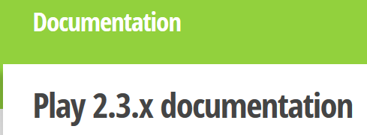

Before new app is created
download binaries
and dependencies
documentation
tutorial
link to external websites
add play to path
Notes:
Binaries → When downloading, a completely functional program without any installer is also often called a program binary, or binaries (as opposed to the source code).
External links: twitter, github, stackoverflow…

Slide 8
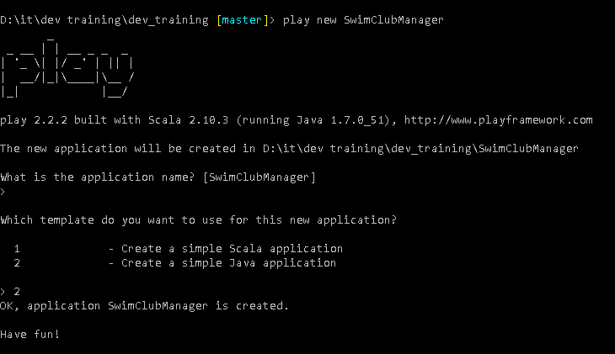
Create new app
Notes:
command: play new SwimClubManager → creates new app
Choose template:
1 – Scala
2 – Java

Slide 9




compiles and builds the application
by default on port 9000
Play! supports hot deployment
play compile, play test
IDE support - commands:
- play eclipse
- play idea
Notes:
Hot deployment → you refresh the page in your web browser and changes are applied, you don’t have to stop the run of the application and compile it again every time you make a change
play compile command allows to just compile the code.
play test will test your application → the template comes with 2 tests – a unit test and an integration test
play eclipse/idea → Created the necessary files to open, run and edit a Play application

Slide 10
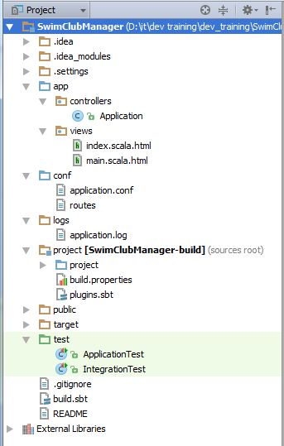
Project structure
app
controllers
views
conf
application.conf
routes
project
public
test
Notes:
app folder
- primary location to store the application source code
- it contains controllers, views, and model code
- it is convention and u can break out of this convention but it may need some configuration changes
conf folder
- holds non-source files that relate to the configuration of the application
- this includes application.conf file, the default and primary source for configuration data in the application
- also contains routes file, which is the central definition of all routes or endpoints of the application and their respected parameters
project folder
- contains files that are used to define the project and configuration necessary to build and run the application
- the build file is actually a Scala file, cos the underlying build system is SBT; the Simple Build Tool, which uses Scala and a Scala-like DSL for build definitions
public folder
- holds all the static assets that your application will want to serve, such as images, javascripts, and CSS
test folder
- default place to create any tests
- can be Ats, UTs…
- can include any test-specific resources you may need as well

Slide 11
Based on Pluralsight course by James Hughes
Other sources:
stackoverflow
Coming soon…
How to write high quality code (Python)?

